Slide 1
Linear models

Slide 2
Linear models: A category of inference
For classification problems with numeric predictive attributes, the simplest, but important, type of inference is a linear model.
The tuple of values of k predictive attributes is a point in R^{k}.
Boolean classification attribute:
  Classifier is a hyperplane in R^{k}.
  Points on one side are predicted to have value True; on the other side, are predicted to have value False.
Discrete classification attribute:
  Classifier is a partition of R^{k} by hyperplanes. I will not deal with that.
Numeric classification attribute:
  Classifier is a hyperplane in R^{k}. Points are predicted to lie on the hyperplane.
  Standard statistical linear regression.

Slide 3
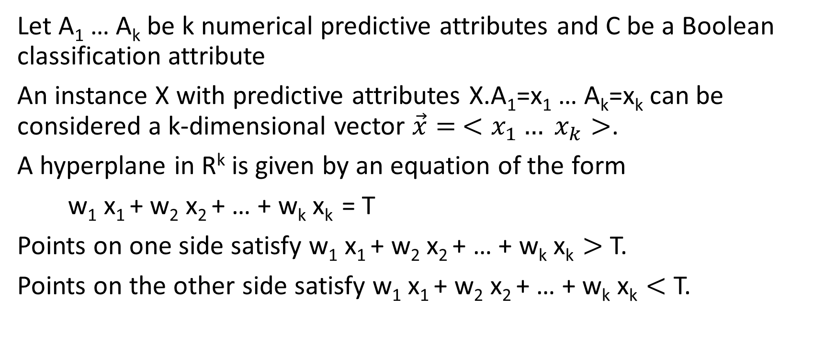
Hyperplane
Let A₁ … A_{k} be k numerical predictive attributes and C be a Boolean classification attribute
An instance X with predictive attributes X.A₁=x₁ … A_{k}=x_{k} can be considered a k-dimensional vector $\vec{x}= <x_{1}… x_{k}>$.
A hyperplane in R^{k} is given by an equation of the form
w₁ x₁ + w₂ x₂ + … + w_{k} x_{k} = T
Points on one side satisfy w₁ x₁ + w₂ x₂ + … + w_{k} x_{k} $>$ T.
Points on the other side satisfy w₁ x₁ + w₂ x₂ + … + w_{k} x_{k} $<$ T.

Slide 4
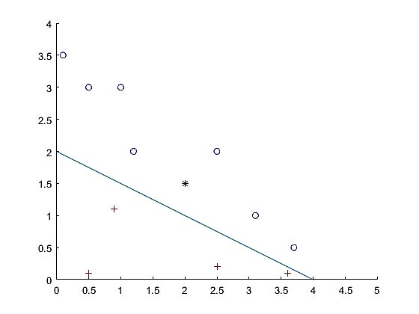
Example: k=2
The line satisfies the equation x+2y = 4.
The blue circles satisfy x+2y > 4.
The red crosses satisfy x+2y < 4.
E.g. for blue circle <0.5,3>,
1 ∙ 0.5 + 2 ∙ 3 = 6.5 > 4
For red cross <0.5, 0.1>,
1 ∙ 0.5 + 2 ∙ 3 = 6.5 > 4
So given a new point (black asterisk <2,1.5>, compute
1 ∙ 2 + 2 ∙ 1.5 = 5 > 4, so predict blue.

Slide 5
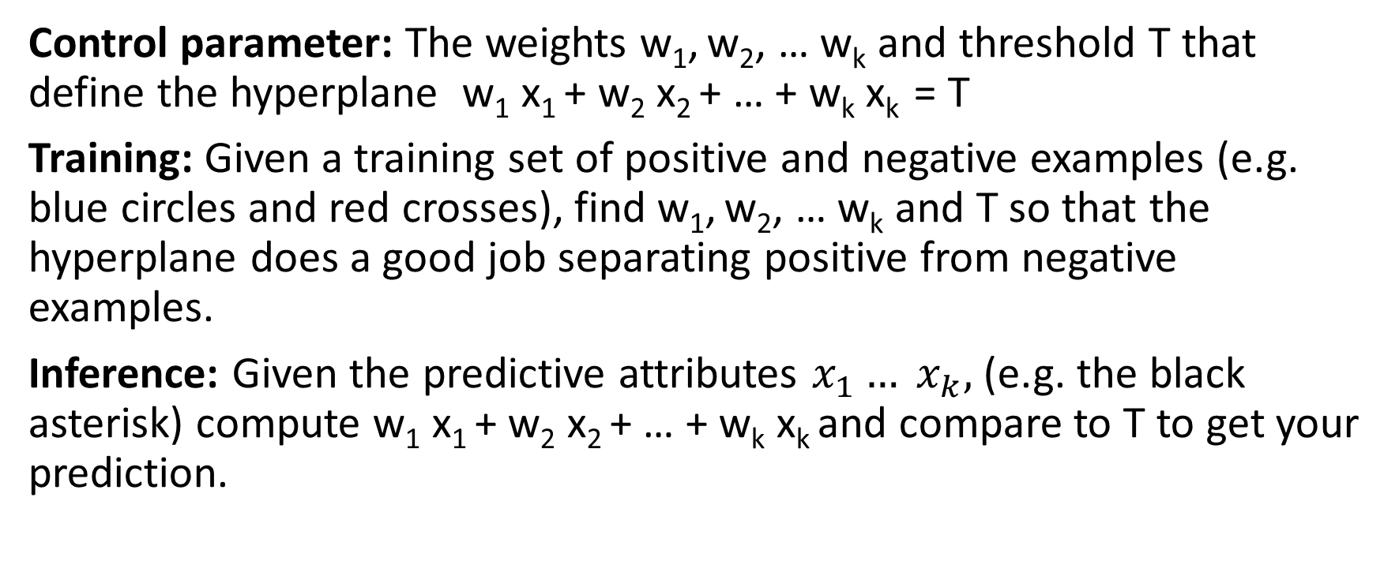
Overall process
Control parameter: The weights w₁, w₂, … w_{k} and threshold T that define the hyperplane w₁ x₁ + w₂ x₂ + … + w_{k} x_{k} = T
Training: Given a training set of positive and negative examples (e.g. blue circles and red crosses), find w₁, w₂, … w_{k} and T so that the hyperplane does a good job separating positive from negative examples.
Inference: Given the predictive attributes $x_{1}… x_{k},$(e.g. the black asterisk) compute w₁ x₁ + w₂ x₂ + … + w_{k} x_{k} and compare to T to get your prediction.

Slide 6
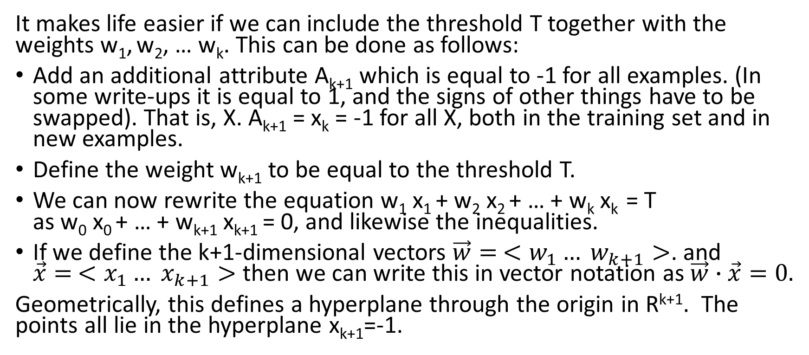
Mathematical simplification
It makes life easier if we can include the threshold T together with the weights w₁, w₂, … w_{k}. This can be done as follows:
Add an additional attribute A_{k+1} which is equal to -1 for all examples. (In some write-ups it is equal to 1, and the signs of other things have to be swapped). That is, X. A_{k+1} = x_{k} = -1 for all X, both in the training set and in new examples.
Define the weight w_{k+1} to be equal to the threshold T.
We can now rewrite the equation w₁ x₁ + w₂ x₂ + … + w_{k} x_{k} = T
as w₀ x₀ + … + w_{k+1} x_{k+1} = 0, and likewise the inequalities.
If we define the k+1-dimensional vectors $\vec{w}= <w_{1}… w_{k+1}>$. and
$\vec{x}= <x_{1}… x_{k+1}>$ then we can write this in vector notation as $\vec{w}∙\vec{x}=0.$
Geometrically, this defines a hyperplane through the origin in R^{k+1}. The points all lie in the hyperplane x_{k+1}=-1.

Slide 7
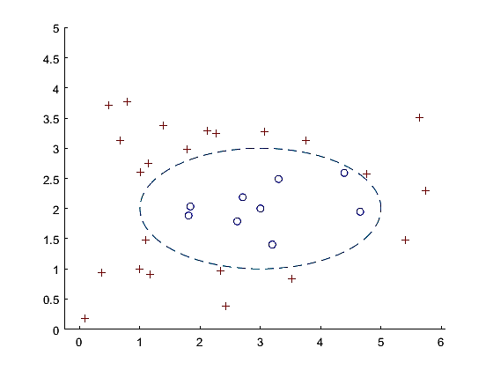
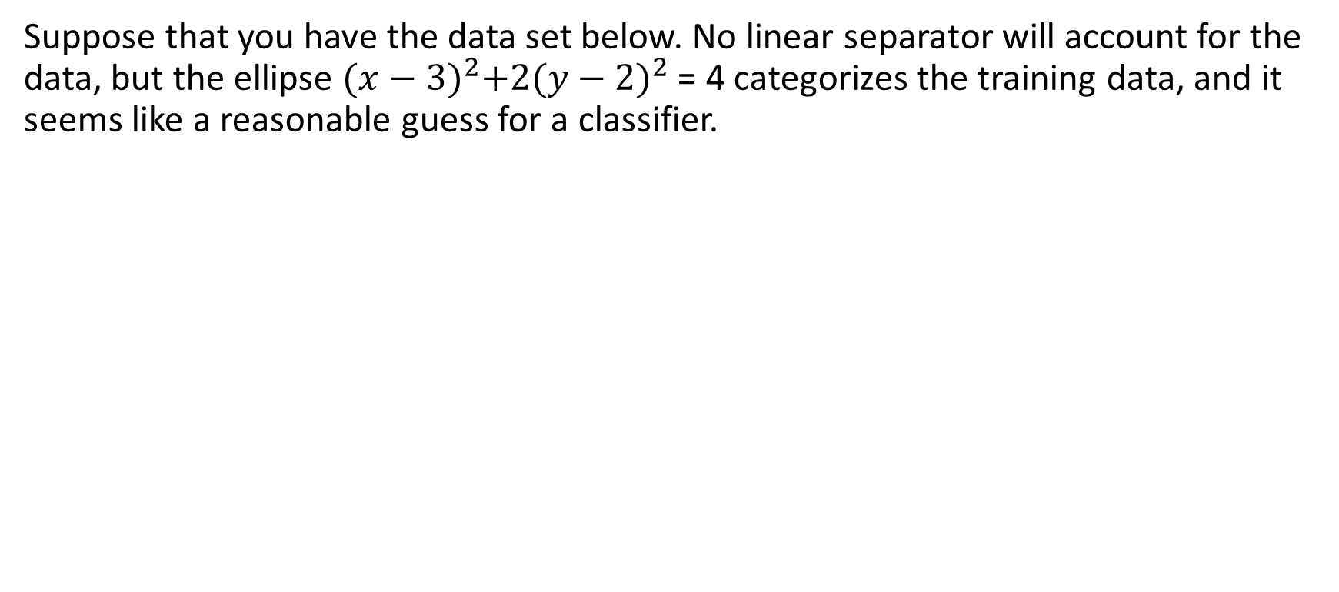
Using linear models for non-linear categories by increasing the dimension (generally associated with SVMs but not limited to those)
Suppose that you have the data set below. No linear separator will account for the data, but the ellipse ${(x−3)}^{2}+2{(y−2)}^{2}$ = 4 categorizes the training data, and it seems like a reasonable guess for a classifier.

Slide 8
Turning a non-linear problem into a linear problem
As always in ML, you have to choose a process for the inference level controlled by a control parameter = a class of models for the inference level.
Suppose we want to consider the class of all conic sections (circle, ellipse, parabola, hyperbola, line). A conic section is defined by a quadratic equation
Ax² + Bxy + Cy² + Dx + Ey + F = 0
So the control parameter is the 6-tuple of numbers <A,B,C,D,E,F>.
However, for any particular data point, <x,y,c> (c∊{T,F}) this is a linear inequality in the parameters A…F, though it is a non-linear function of the data values x and y.

Slide 9
Example
Suppose the data set is
X Y C
2 F
5 T
2 F
1 T
3 F
4 T
0 1 T
Then, since the classifier is defined by
Ax² + Bxy + Cy² + Dx + Ey + F = 0
the corresponding inequalities are
9A + 6B + 4C + 3D + 2E + F < 0
A + 5B + 25C + D + 5E + F > 0
4A + 4B + 4C + 2D + 2E + F < 0
16A + 4B + C + 4D + E + F > 0
4A + 6B + 9C + 2D + 3E + F < 0
9A + 12B + 16C + 3D + 4E + F > 0
C + E + F > 0
One solution to this is A=1,B=0,C=1,D=-4,E=-4,F=6, corresponding to the circle X²+Y²-4X-4Y+6=0

Slide 10
Linear separable category
A category / training set is linearly separable if there is some linear classifier that works perfectly.
If the training set is linearly separable, then it defines a system of linear inequalities over the weights (one inequality per data point).
Linear programming finds the solution to a system of linear inequalities, if one exists. Well studied problem since 1940s, lots of powerful software.
However, linear programming does not give useful approximate output if the category is not linearly separable (e.g. if there is a linear classifier that works on 90% of the data points.)

Slide 11
Complexity result
If a training set is not linearly separable, finding the linear classifier that maximizes accuracy is NP-hard.

Slide 12
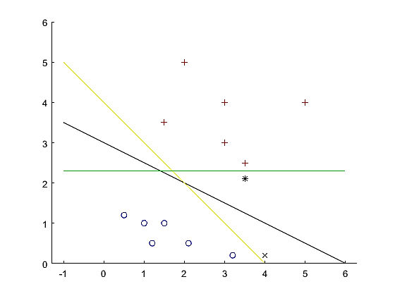
Support vector machines
Some linear discriminators are better than others.
All of these line separate the blue circles from red plusses (training set). But the green line will classify the * test point as a blue circle, even though it is close to a red point. The yellow line will classify the x test point as red, even though it is close to a blue point.

Slide 13
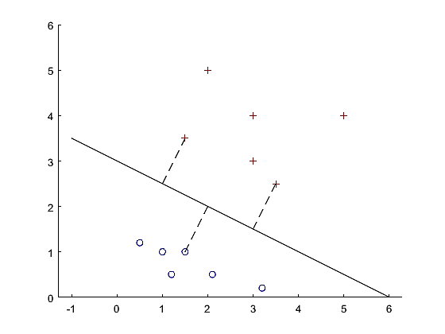
Support Vector Machine
The black line is the support vector machine for this training set. The distance from the line to the closest points in the training set is as large as possible. This distance is called the margin. The closest points are the support vectors; in general, in k dimensions, there are k+1 support vectors.

Slide 14
Support vector machine: Learning
With some algebra, you can cast this as maximizing a quadratic function (the margin squared) subject to linear constraints (partitioning the training points). See Russell and Norvig for details.
With some more finagling, you can adapt this to training sets that are not linearly separable. See Russell and Norvig for details.

Slide 15
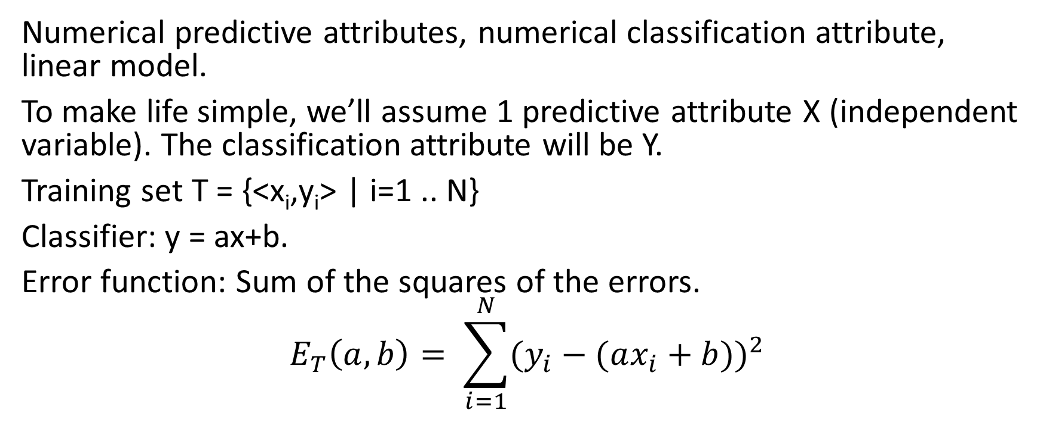
Linear regression
Numerical predictive attributes, numerical classification attribute, linear model.
To make life simple, we’ll assume 1 predictive attribute X (independent variable). The classification attribute will be Y.
Training set T = {<x_{i},y_{i}> | i=1 .. N}
Classifier: y = ax+b.
Error function: Sum of the squares of the errors.
$$E_{T}\left(a,b\right)= \sum_{i=1}^{N}{(y_{i}−(ax_{i}+b{))}^{2}}$$

Slide 16
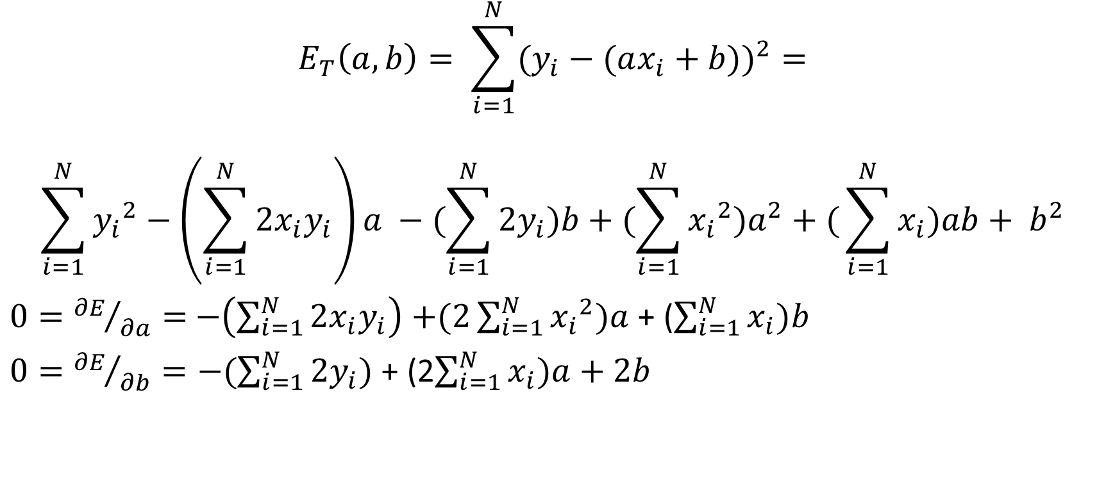
Optimal values of a and b
$$E_{T}\left(a,b\right)= \sum_{i=1}^{N}{(y_{i}−(ax_{i}+b{))}^{2}}=$$
$$\sum_{i=1}^{N}{{y_{i}}^{2}−\left(\sum_{i=1}^{N}{2x_{i}y_{i}}\right)a −(\sum_{i=1}^{N}{2y_{i})b}+(\sum_{i=1}^{N}{{x_{i}}^{2})a^{2}}+(}\sum_{i=1}^{N}{x_{i})ab+ b^{2}}$$
$0={∂E}/{∂a}=$ $−\left(\sum_{i=1}^{N}{2x_{i}y_{i}}\right)$ $+(2\sum_{i=1}^{N}{{x_{i}}^{2})a }$+ ($\sum_{i=1}^{N}{x_{i})b}$
$0={∂E}/{∂b}=−(\sum_{i=1}^{N}{2y_{i})}$ + (2$\sum_{i=1}^{N}{x_{i})a+2b}$

Slide 17
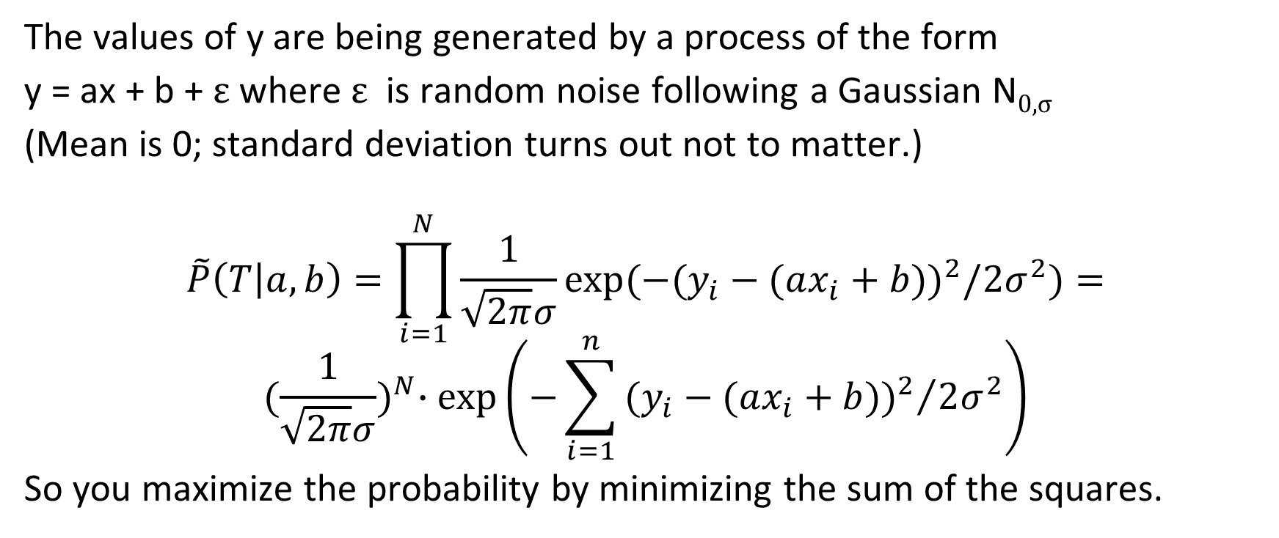
Stochastic generative model
The values of y are being generated by a process of the form
y = ax + b + ε where ε is random noise following a Gaussian N_{0,σ}
(Mean is 0; standard deviation turns out not to matter.)
$$\tilde{P}\left(T | a,b\right)=\prod_{i=1}^{N}{\frac{1}{\sqrt{2π}σ}exp⁡(−(y_{i}}−(ax_{i}+b))^{2}/2σ^{2})=$$
$${(\frac{1}{\sqrt{2π}σ})}^{N}∙\exp\left(−\sum_{i=1}^{n}{{(y_{i}−(ax_{i}+b))^{2}}/{2σ^{2}}}\right)$$
So you maximize the probability by minimizing the sum of the squares.

Slide 18
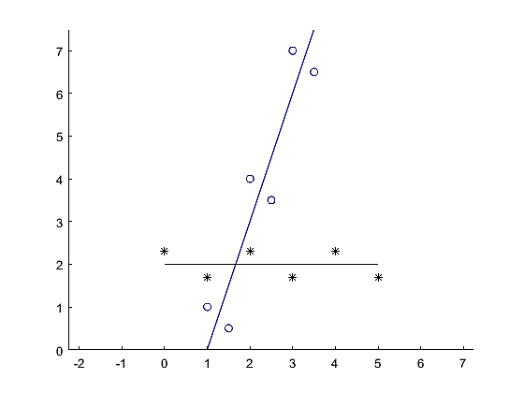
Important note in eyeballing graphs where a curve is fit to data points
The distance squared being minimized is the distance in the y-dimension, not the geometric distance from the points to the line.
The black line fits the black data much better than the blue line fits the blue data.

Slide 19
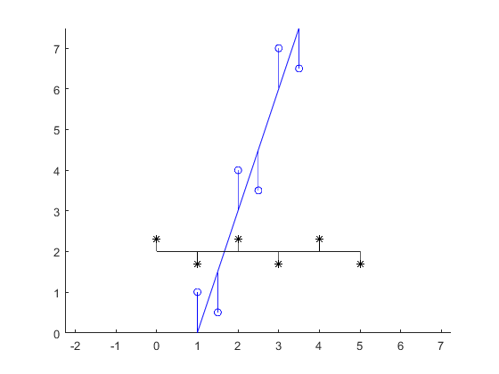
Important note in eyeballing graphs where a curve is fit to data points
The distance squared being minimized is the distance in the y-dimension, not the geometric distance from the points to the line.
The black line fits the black data much better than the blue line fits the blue data.

Slide 20
If you want to minimize the sum of the squared distance using the Euclidean distance to the line, then that is Principal Component Analysis (PCA).
The corresponding stochastic model has equal Gaussian noise in both the x and y directions.

Slide 21
Strengths of linear models
Inference is extremely easy. Training is generally not bad.
Simple, well understood models. Variety of powerful models
Often very effective. SVM’s were the leading ML models from ~2000 to ~2012.
Can be made robust under noise.
Generally robust under repeated attributes, irrelevant attributes scaling issues (SVM’s less so).

Slide 22
Drawbacks of linear models
Limited class of discriminations possible.
Not robust under missing attributes in instances.
Except for linear regression, no probabilistic interpretation.

